Slide 1
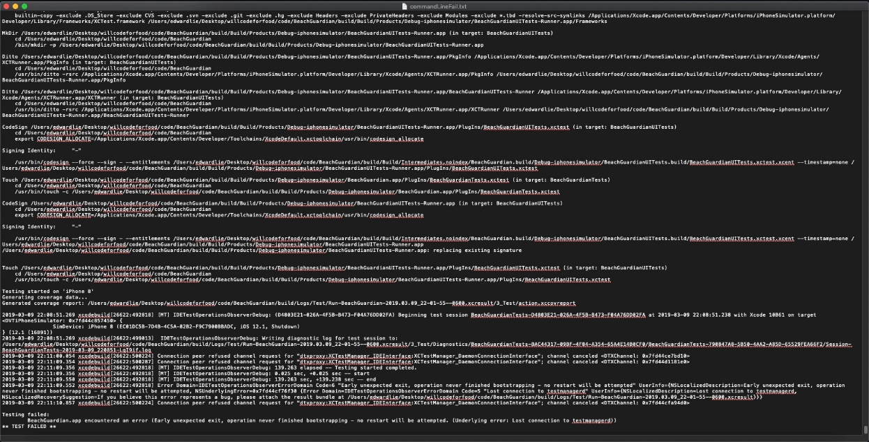
Edward – Week 6 (1)
This past week I came across a problem with my XCode settings that prevented me from running tests against the Jenkins build file.
Hours from multiple days was spent to figure out the root of the issue to no avail even with the help of other group members.

Slide 2
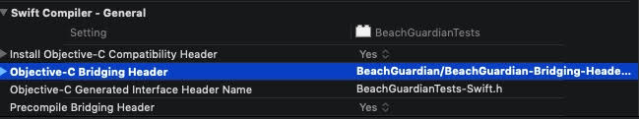
Edward – Week 6 (2)
The result of the process resulted in a log file generated for the professor. More research will have to be done to look into the problem.
I spent the rest of the time researching, setting up, beginning unit testing, and refactoring code.
Pod file changed to begin testing the photo alert action class.
Changes made at the project level

Slide 3
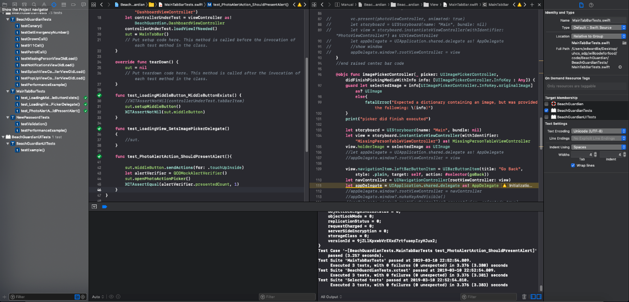
Edward – Week 6 (3)
I was able to get a couple of unit tests created and upon running them passed all tests successfully.
My week 6 goal is to finish the rest of the tests focusing on S3 testing and continue working with the professor to see how I can solve the “XCTestManager connection refused” error which has been affecting only my machine in the group.

